Slide 1
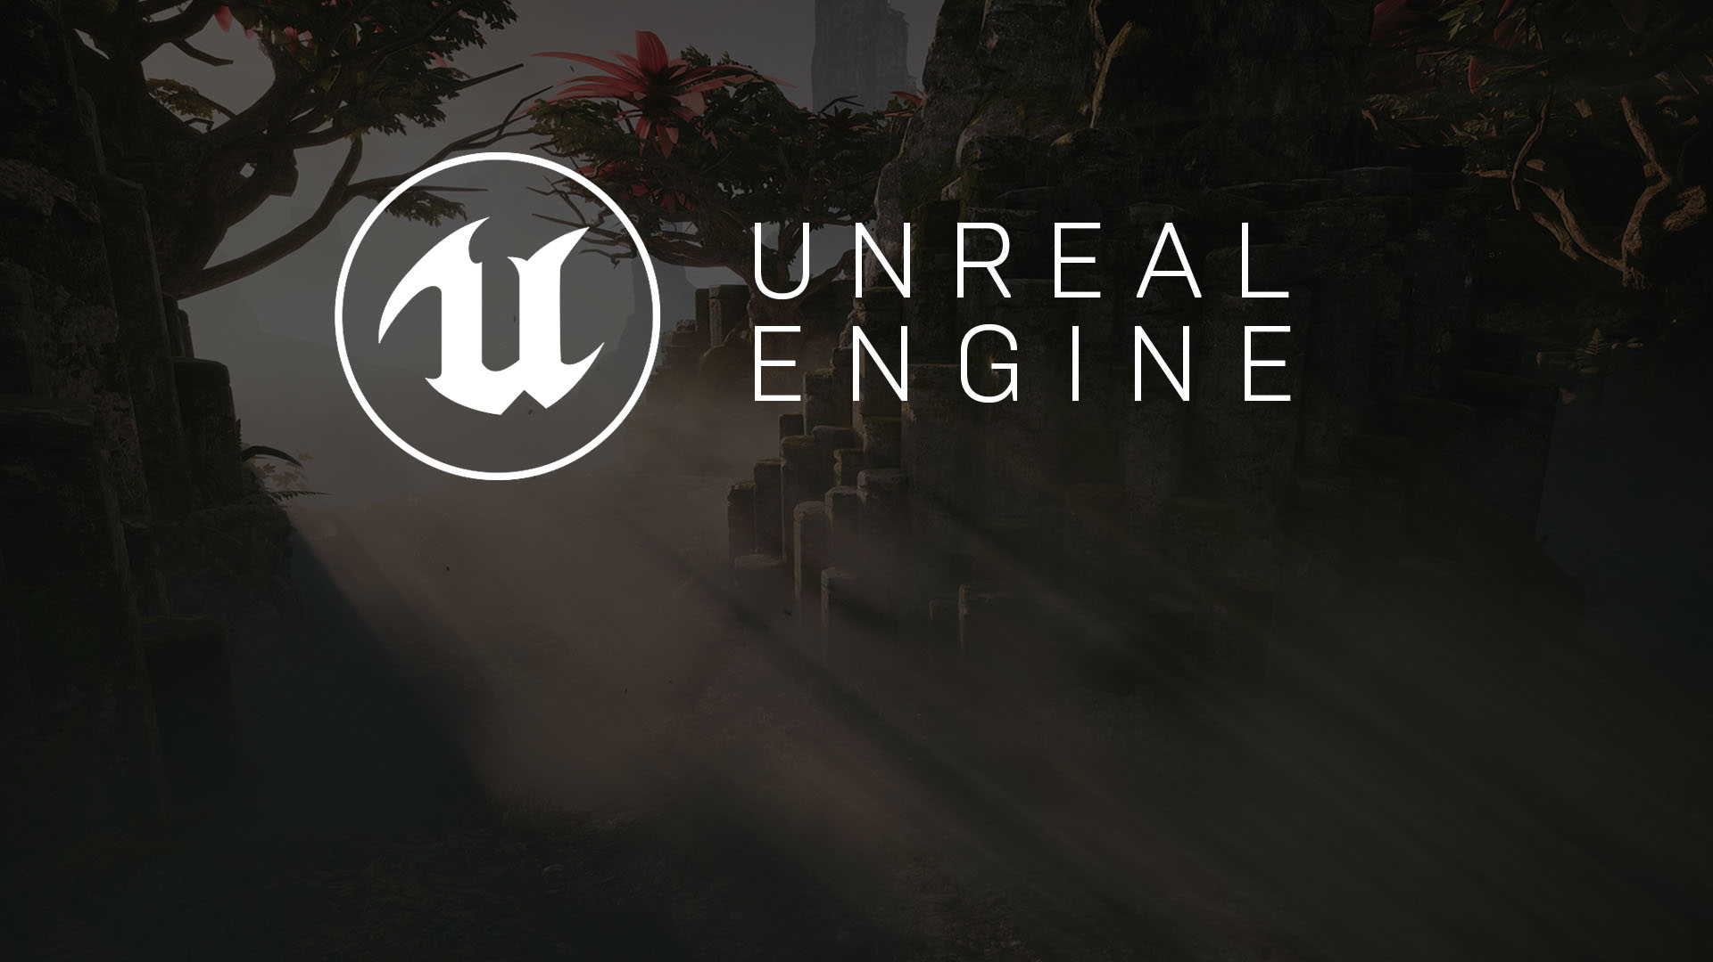
ATTACK ANIMATION MECHANICS
Homework’s Solution

Slide 2

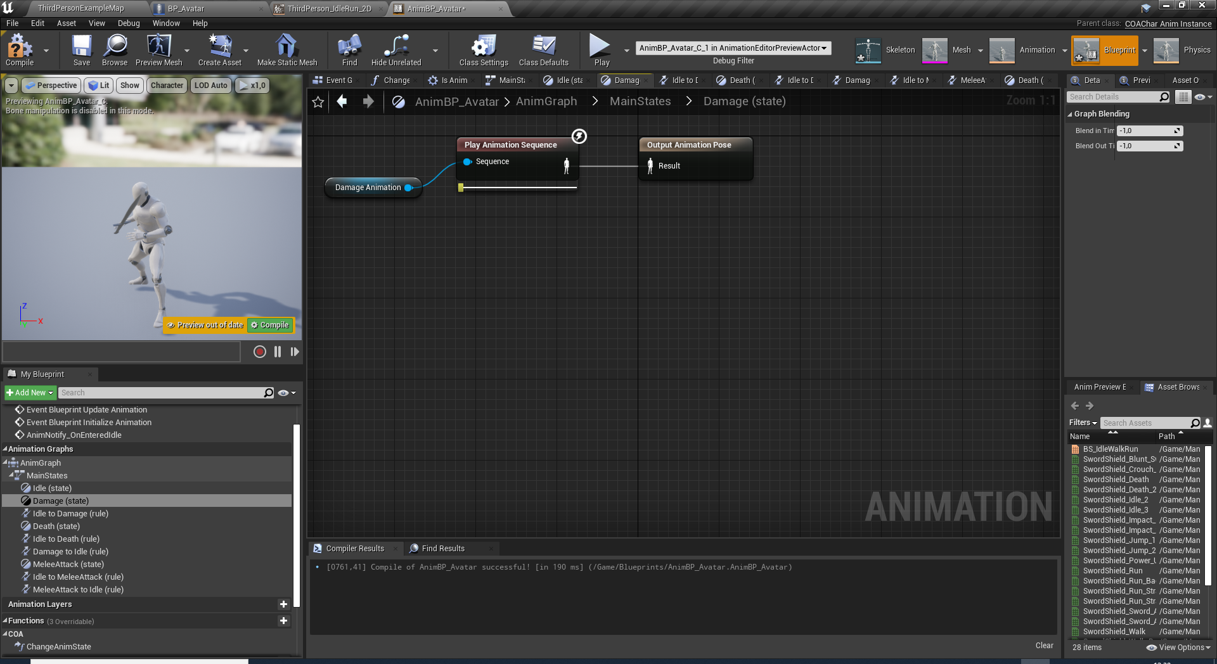
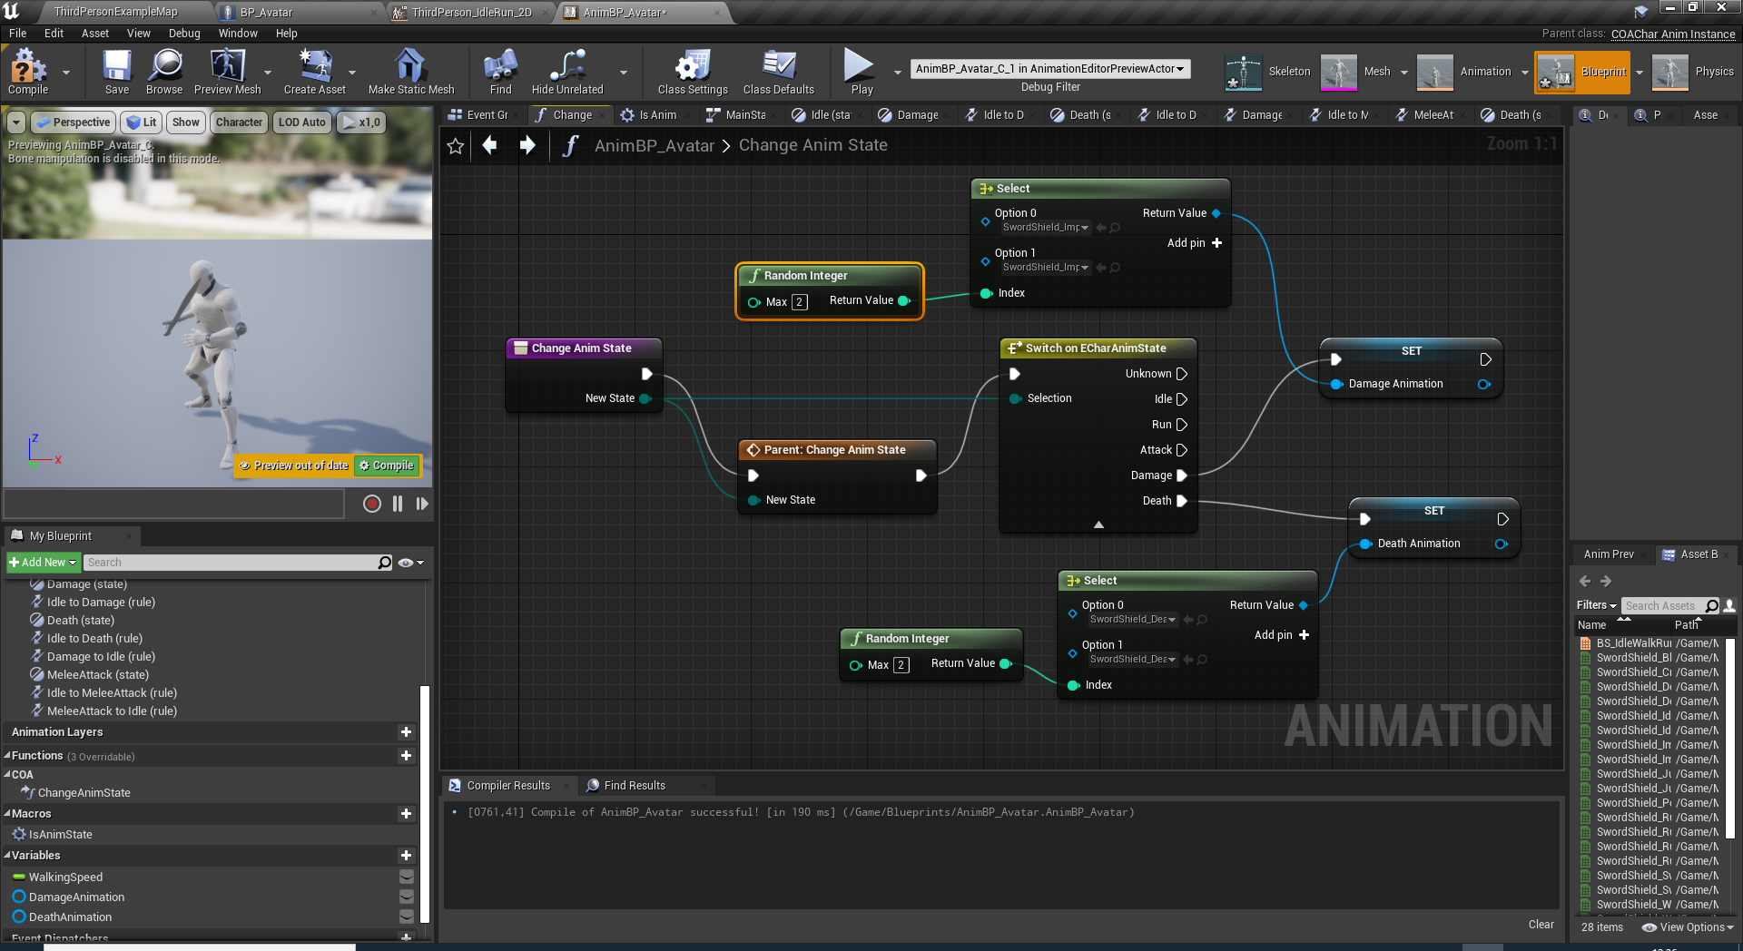
RANDOMIZING ANIMATIONS
Promote Damage and Death anim state inputs by exposing player’s sequence pin and promoting them into variables: DamageAnimation, DeathAnimation
Add switch states to ChangeAnimState function to select the randomized animation.

Slide 3
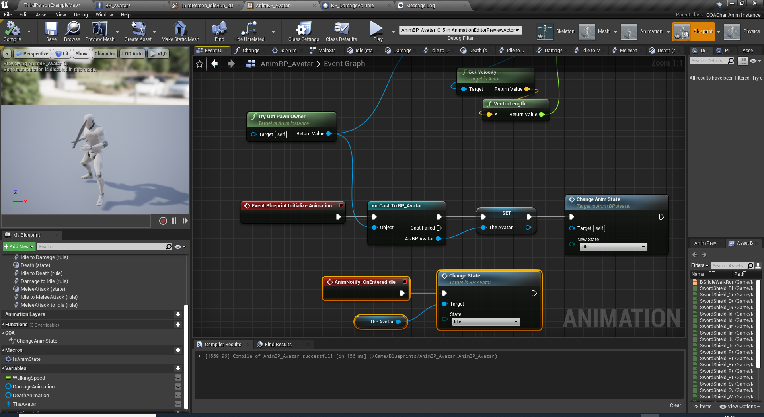
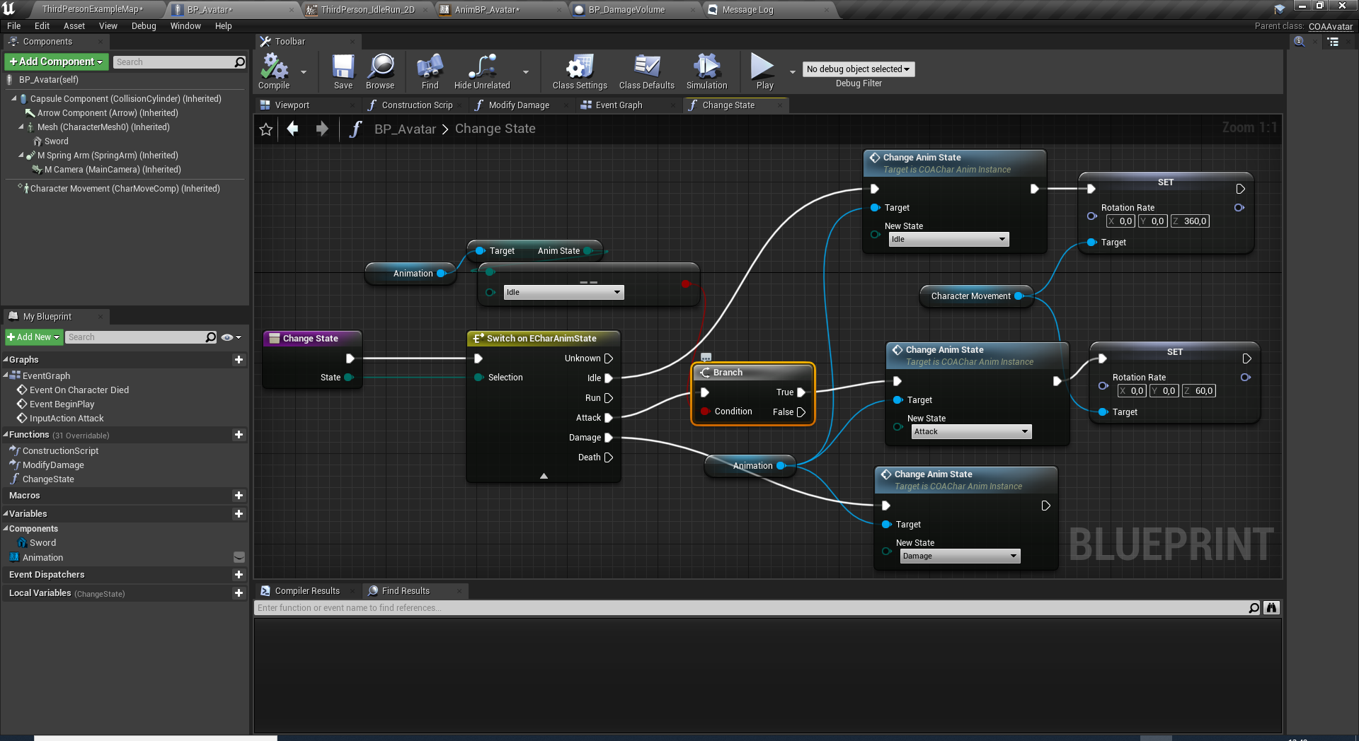
CONTROLLING/LIMITING ORIENT ROTATION
Animation Blueprint now change BP_Avatar’s main state while notifyIdle event.
This will provide the orientation parameter switch properly.
Decreasing RotationRate is another option to prevent character rotate while attacking.

Slide 4
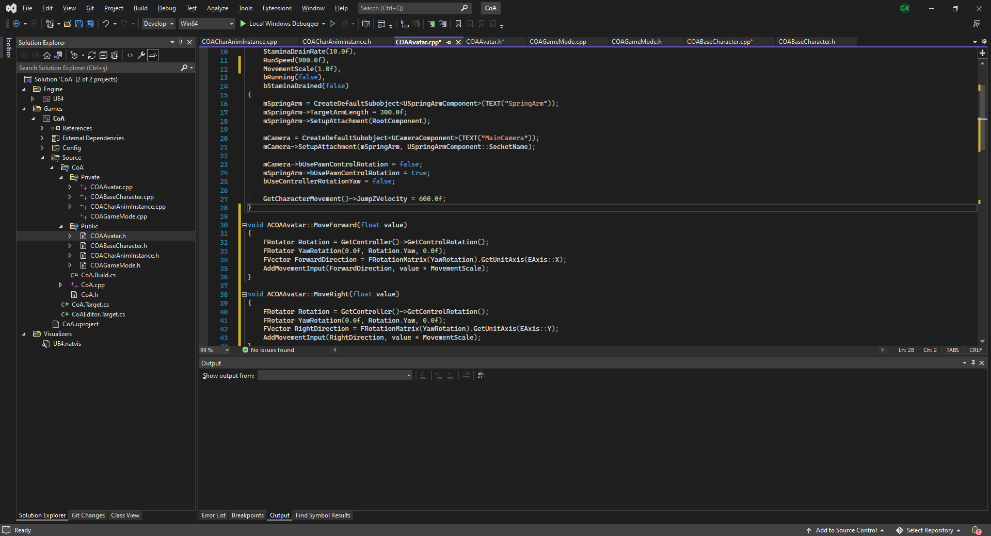
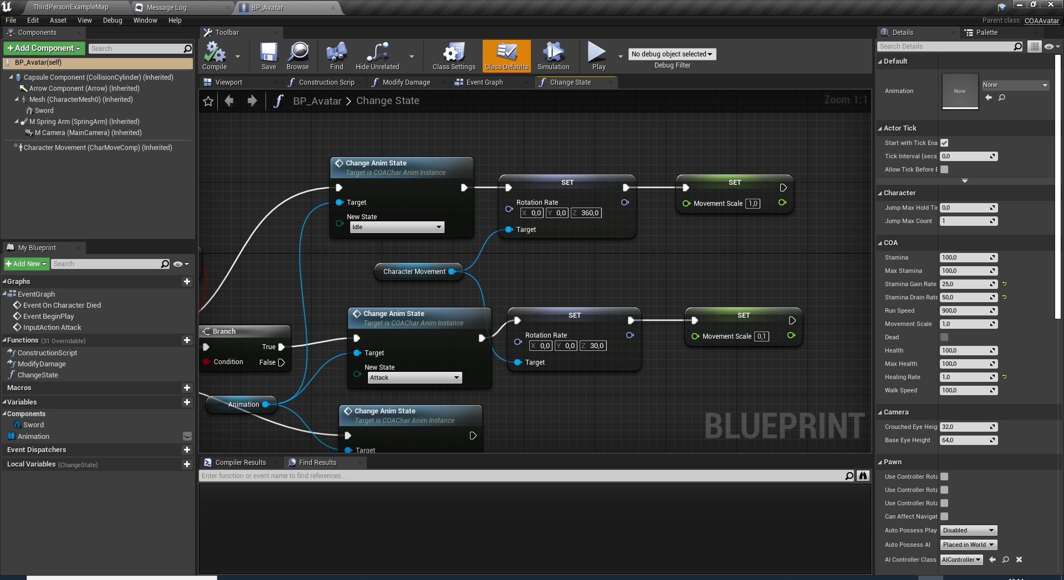
CONTROLLING/LIMITING MOVEMENT
Add MovementScale (Default: 1.0f) float property to COAAvatar class.
Multiple value of MoveForward() and MoveRight() functions with MovementScale.
Change MovementScale during animstate change.

Slide 5
CODING ATTACK STATE
Basic Combat Mechanics

Slide 6
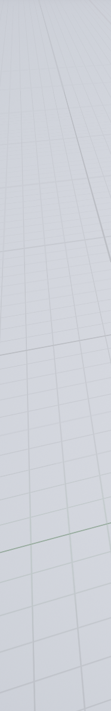
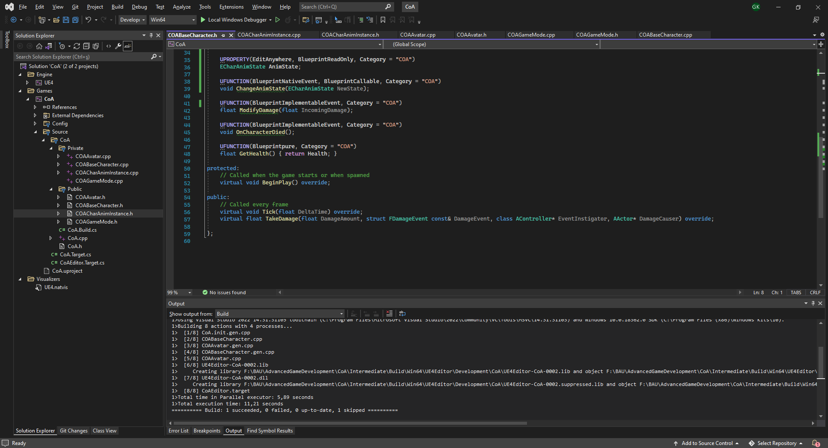
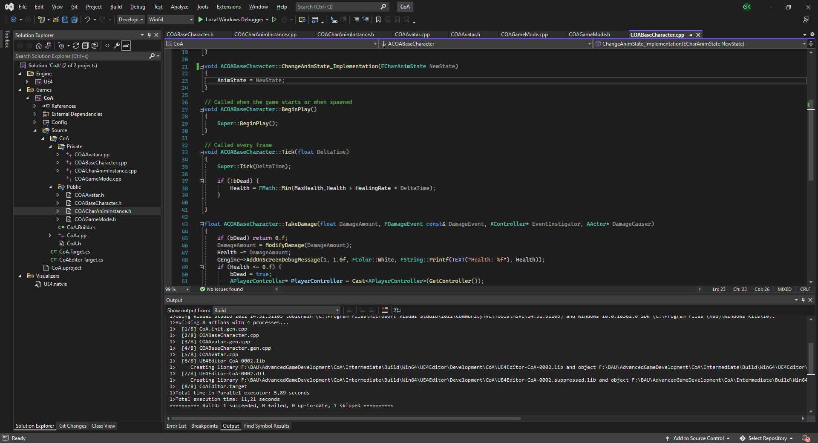
ENEMIES
Create a new Blueprint class inheriting COABaseCharacter.
Set Mannequin as the skeletal mesh and apply translations/rotations similar to the avatar.
Choose AnimInstance as AnimBP_Avatar.
Since all our character would use the same skeleton, we may consider using the same Anim BP for every character.
But for this we need a common interface to change the COABaseCharacter’s Animation State.
Goto COABaseCharacter.h and add
#include "COACharAnimInstance.h" to access ECharAnimState enum.
- Add AnimState property and ChangeAnimState Native event which the implementation will only set the property to the new value.

Slide 7
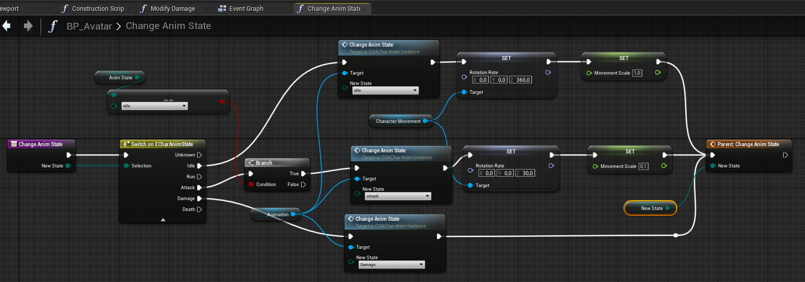
Compile and go back to BP_Avatar.
Override ChangeAnimState function.
Replace all instances of ChangeState function to ChangeAnimState.
Contents of the function has to be changed to reflect the property.
ENEMIES

Slide 8
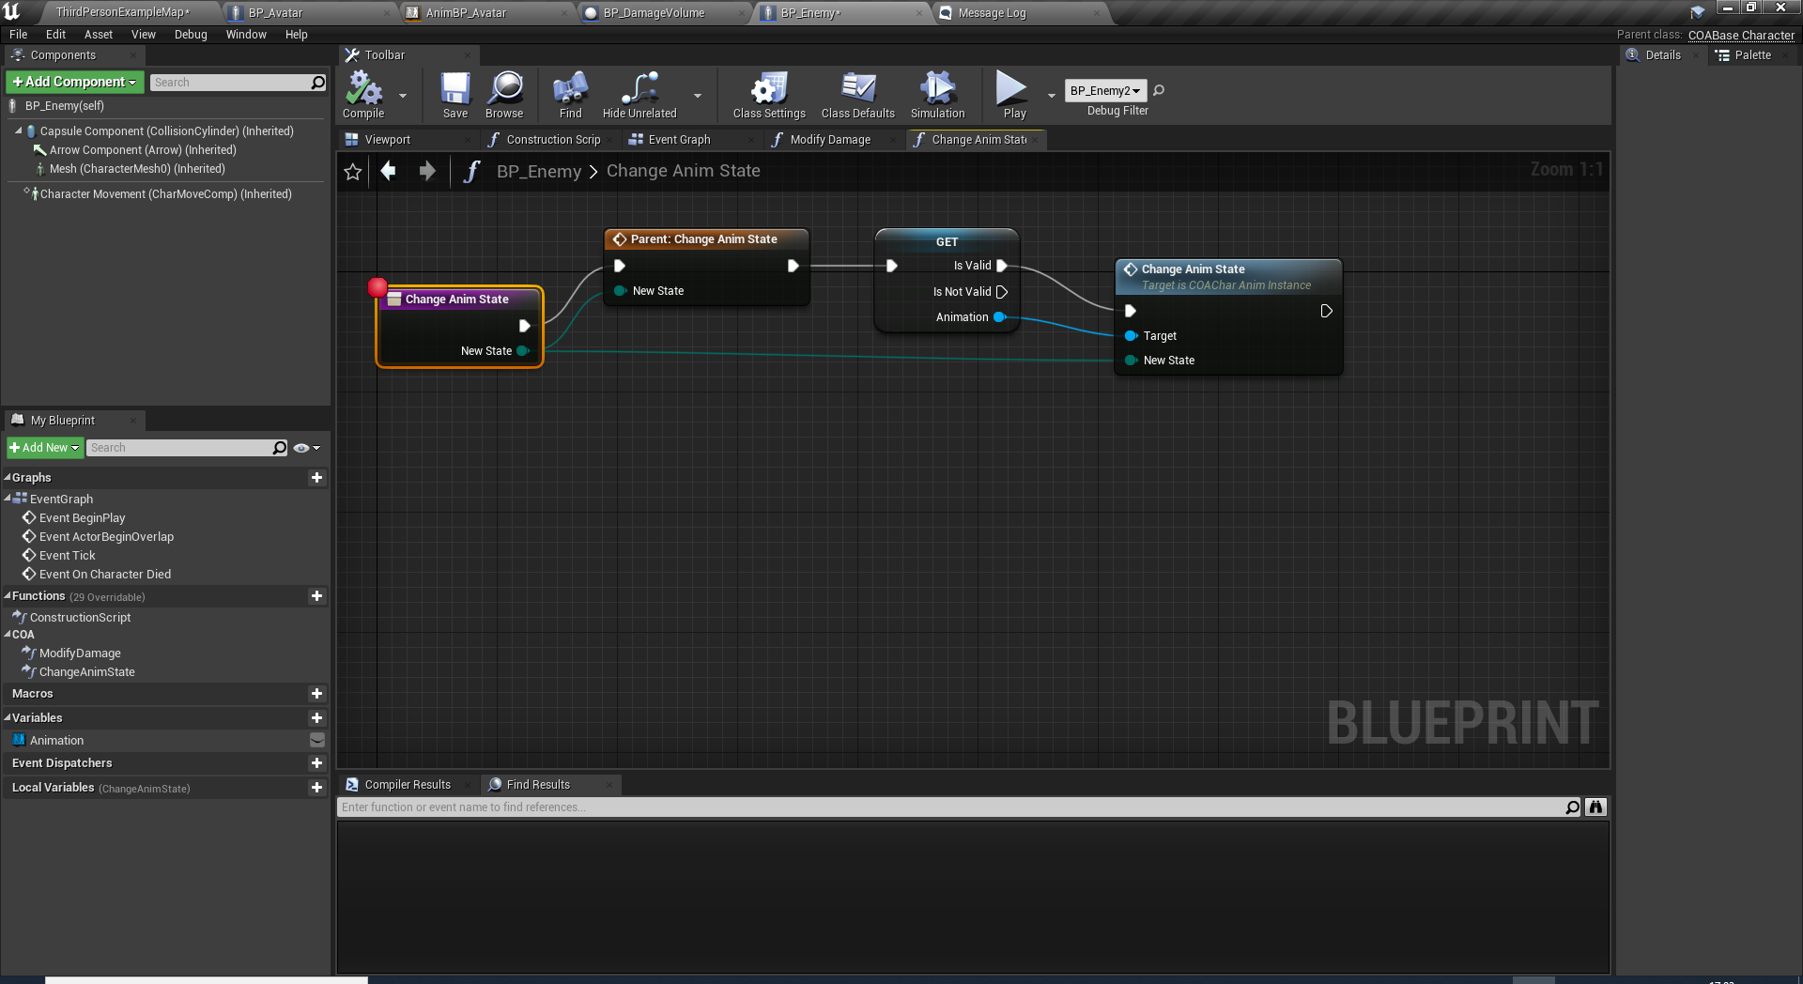
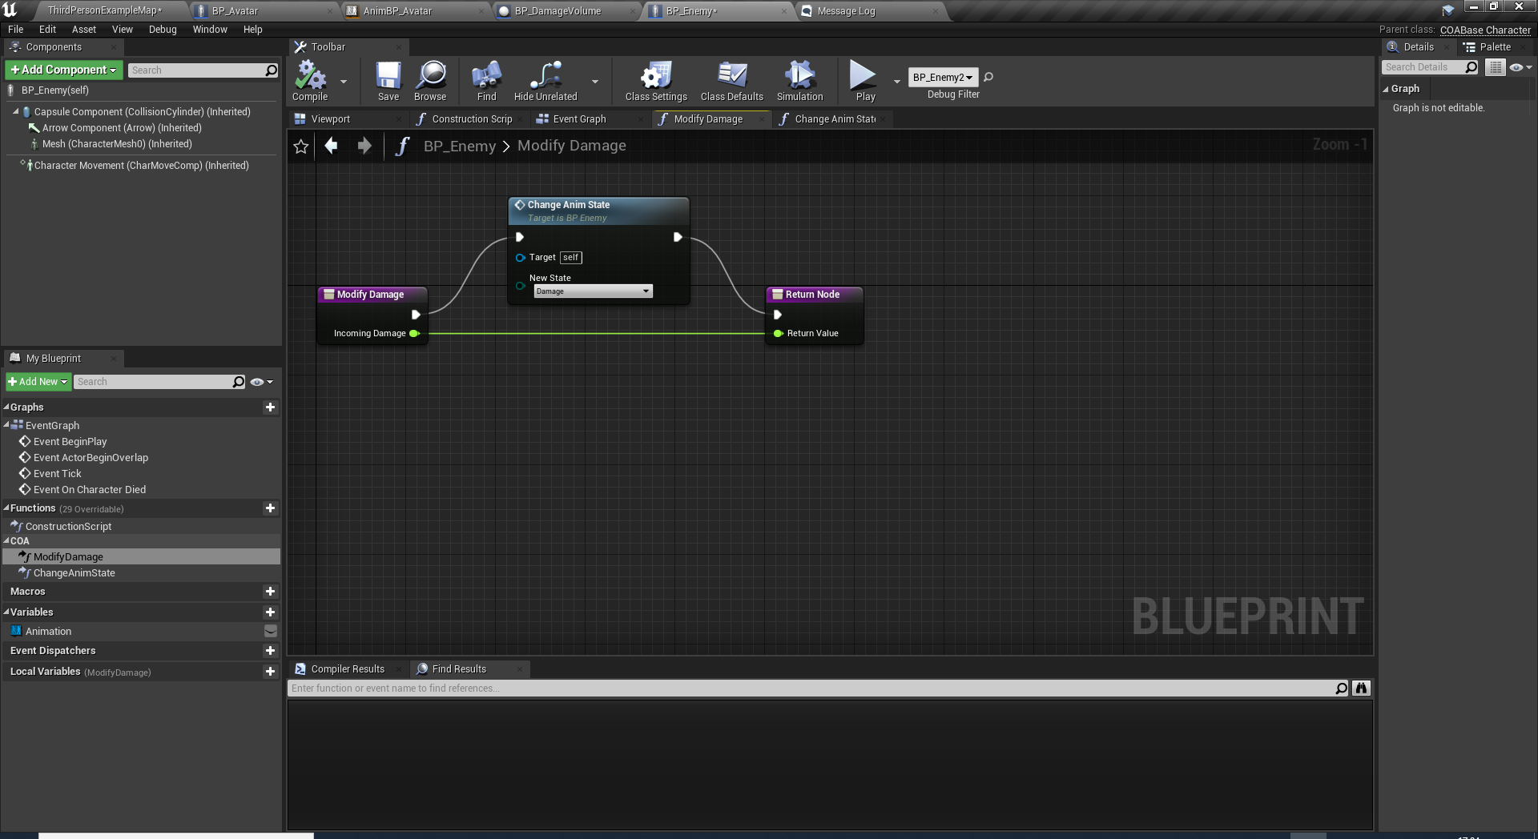
BP_ENEMY
Override ChangeAnimState function in BP_Enemy.
Override ModifyDamage event as the anim state will directly change into damage.
- Also you may consider renaming AnimBP_Avator to AnimBP_BaseCharacter since it is no longer specific to the avatar players.

Slide 9
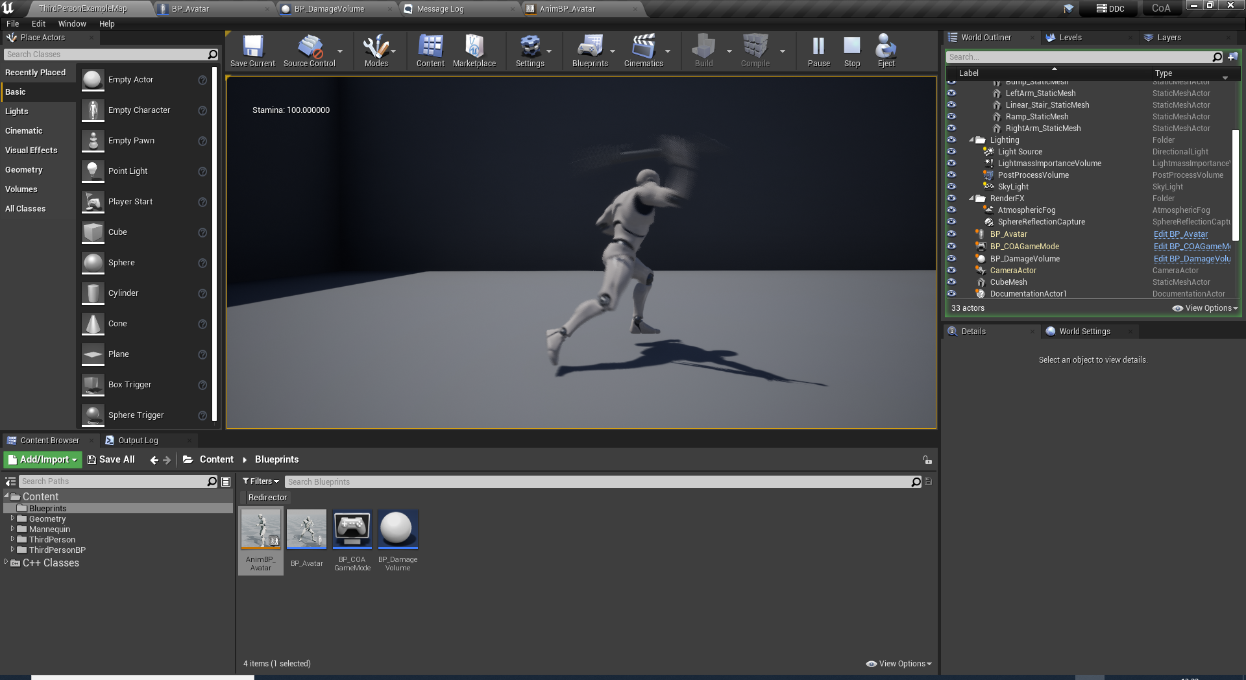
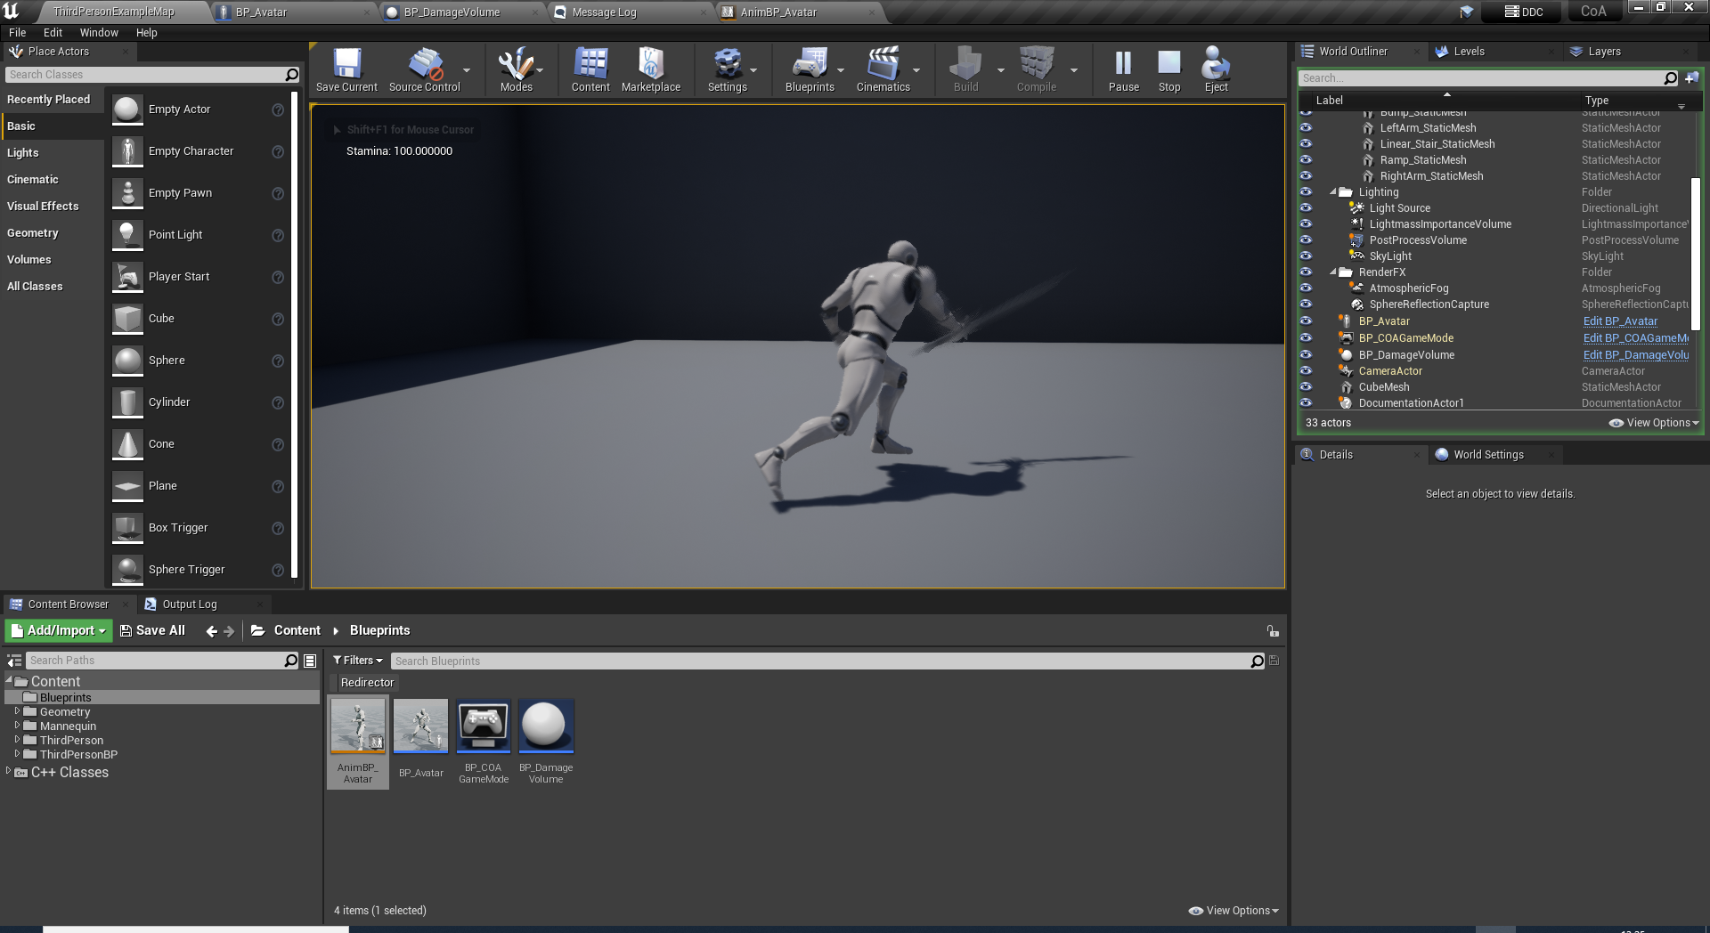
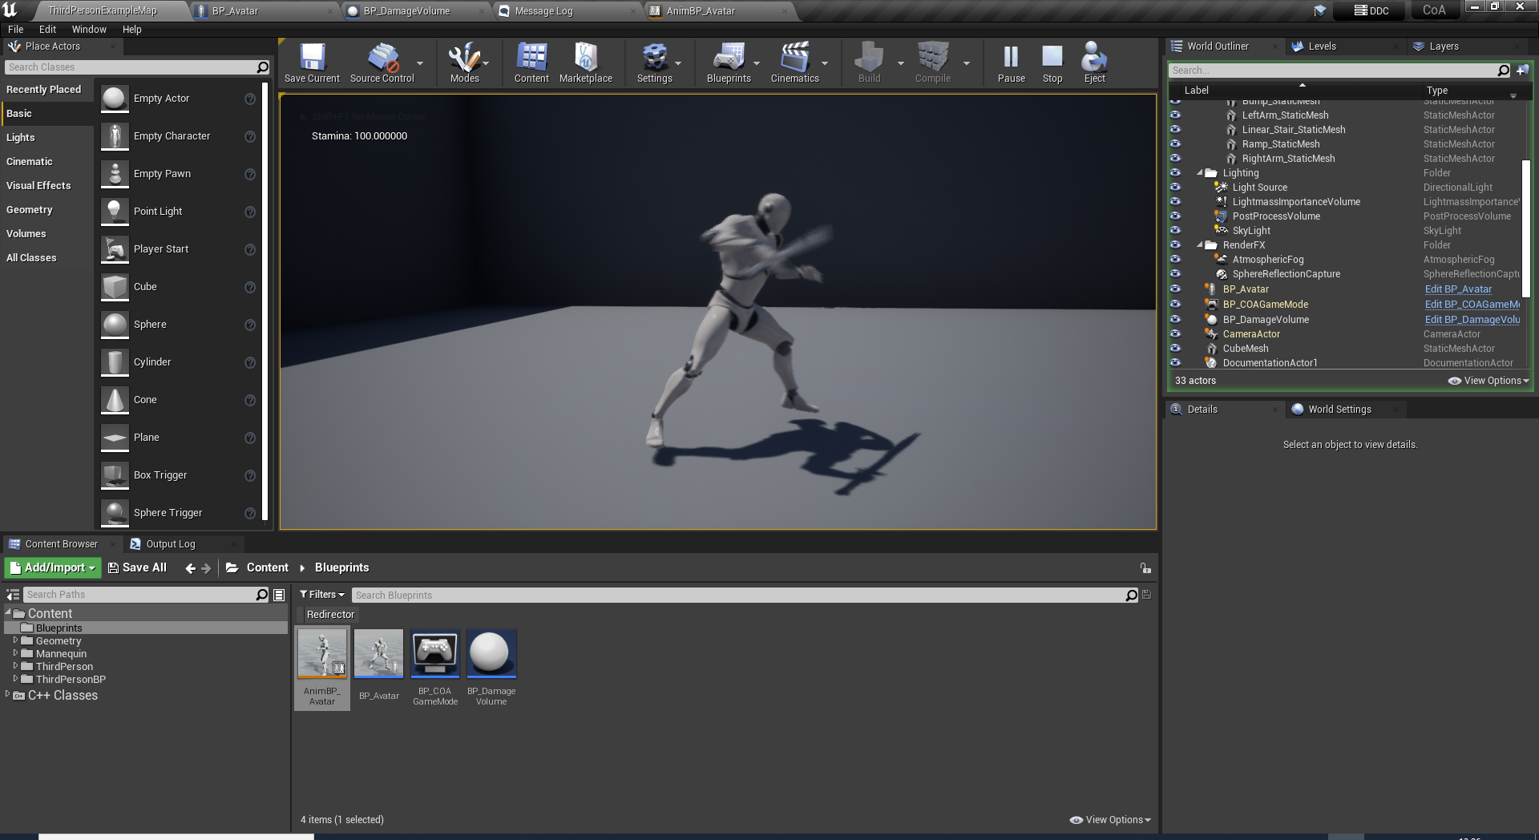
UNDERSTANDING ATTACK PHASES
A Basic melee attack is consisting of 3 phases:
1- Start-up frames
2- Active (Attack) frames
3- Recovery frames
Total animation duration = Startup + Active + Recovery
Requirements:
We need a way to tune these phases with script.
An on the-fly way to change them if stat-bound features like attack-speed changes.
Each attack type should be put into a database to be used when a related weapon is equipped.

Slide 10
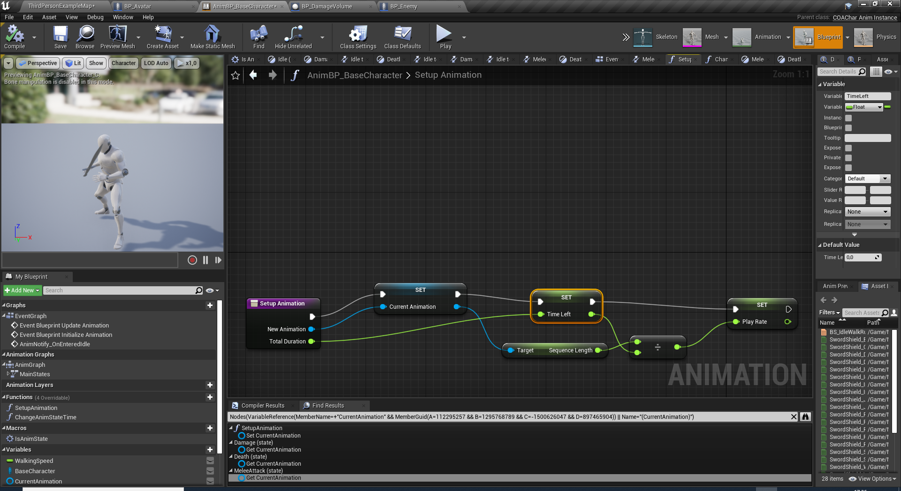
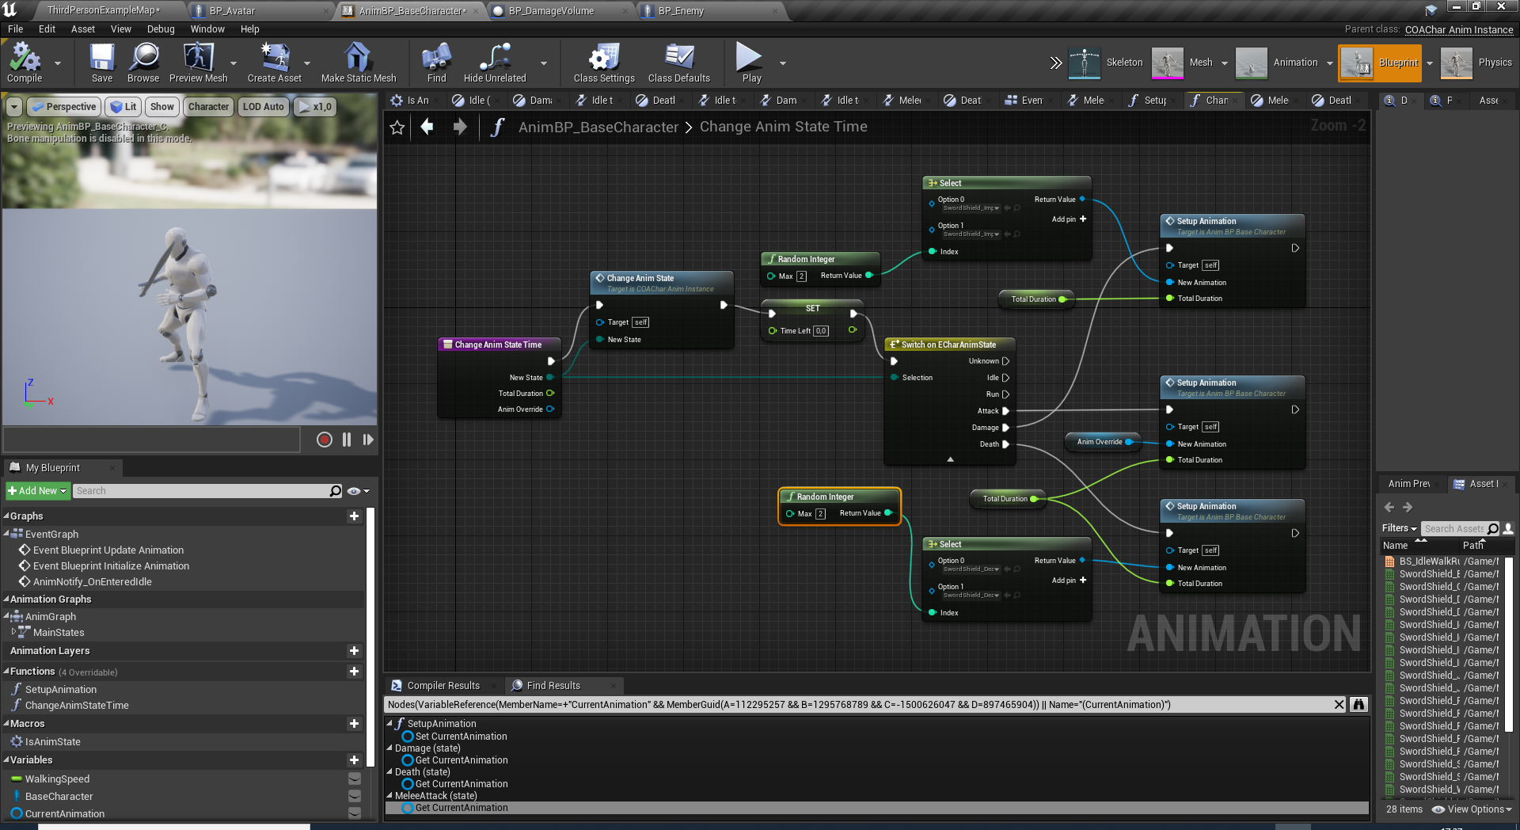
AnimBP_BaseCharacter
Override ChangeAnimState function in BP_Enemy.
Override ModifyDamage event as the anim state will directly change into damage.
Also you may consider renaming AnimBP_Avator to AnimBP_BaseCharacter since it is no longer specific to the avatar players.
Add SetupAnimation() function and CurrentAnimation, TimeLeft, PlayRate variables.
Remove ChangeAnimState function and change contents to a new function: ChangeAnimStateTime.
This new function will be used to have more control over out set animations by setting the total duration of the animation. And override the default animation if necessary with AnimOverride parameter.

Slide 11
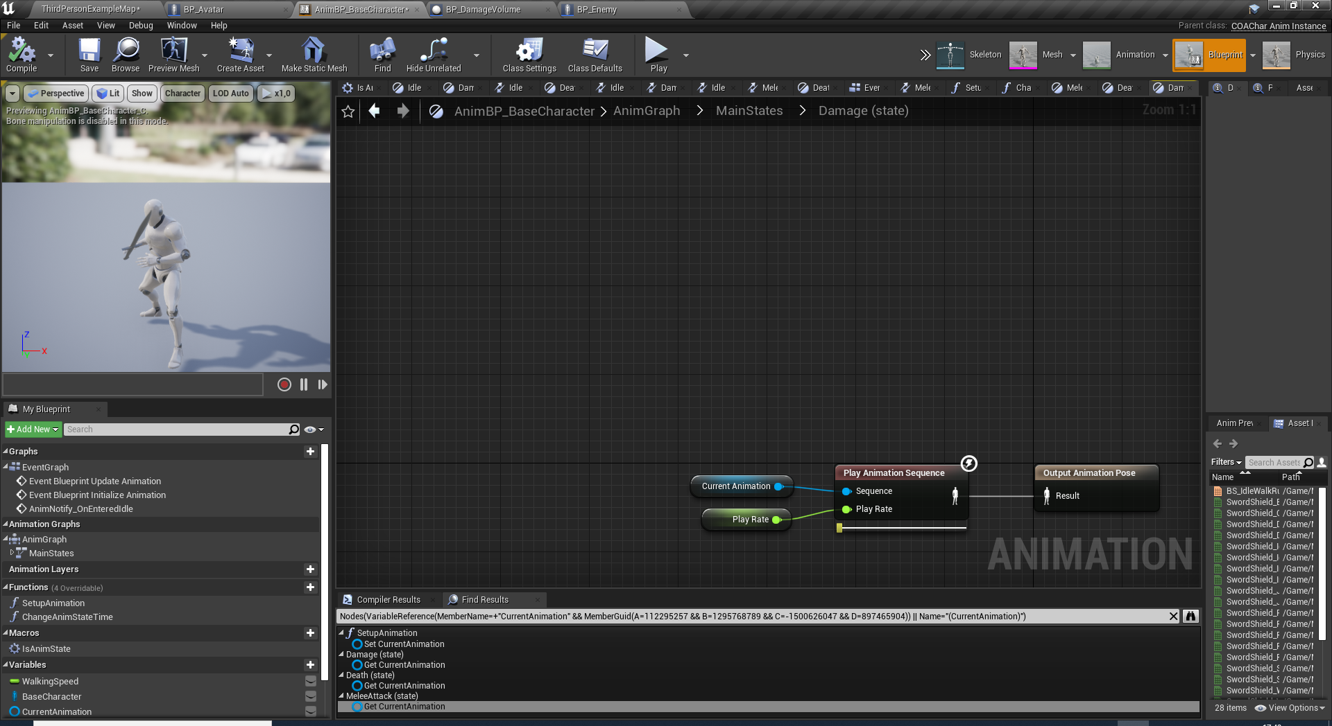
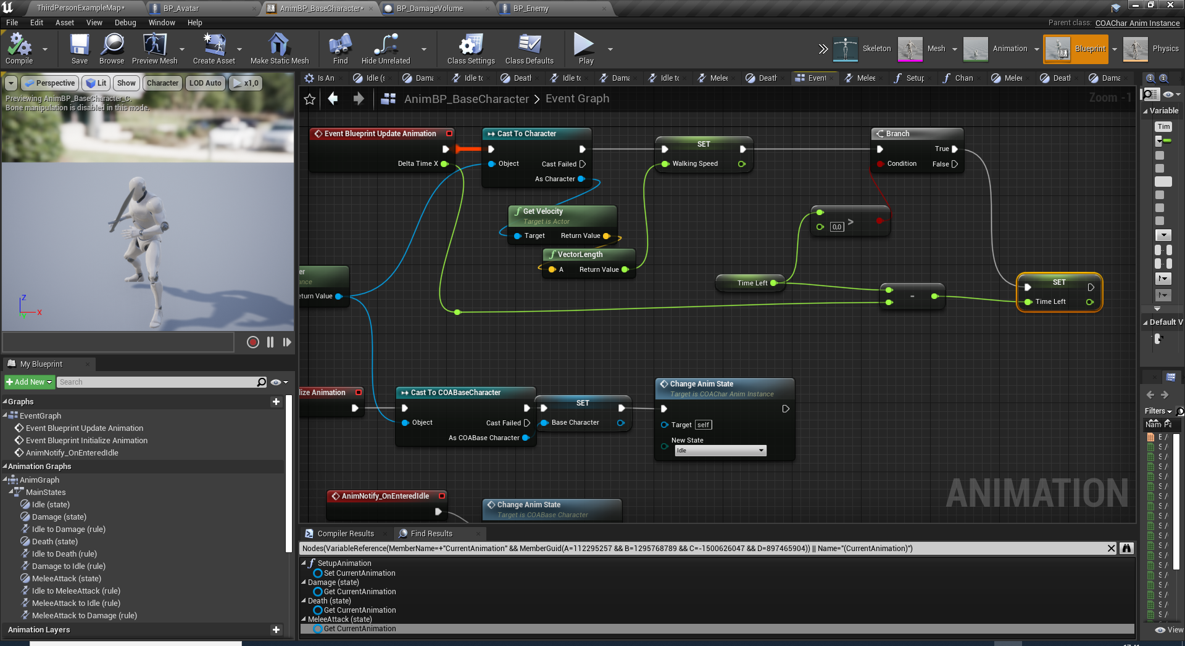
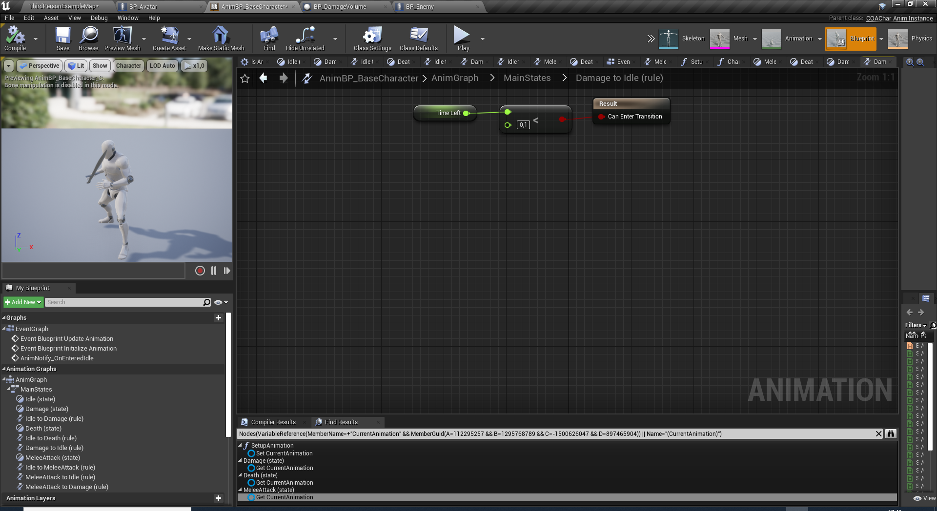
AnimBP_BaseCharacter
Remove DeathAnimation and DamageAnimation variables by replacing them CurrentAnimation.
Also expose PlayRate pins of PlayAnimationSequences and connect them the new PlayRate variable.
BlueprintUpdateAnimation() event should also decrease the TimeLeft variable to control state changes. Since we no longer use remainingRatio nodes and replace them with TimeLeft variable.

Slide 12
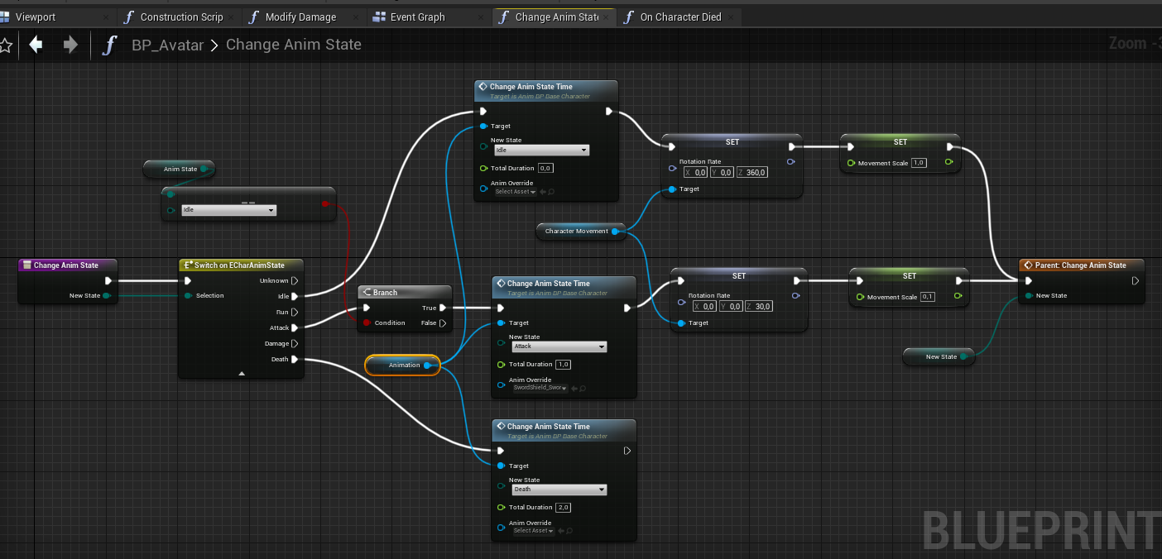
Change variable type of Animation to AnimBP_BaseCharacter so we can access new ChangeAnimStateTime function.
Rearrange the function to use the time adjusted animations.
BP_AVATAR

Slide 13
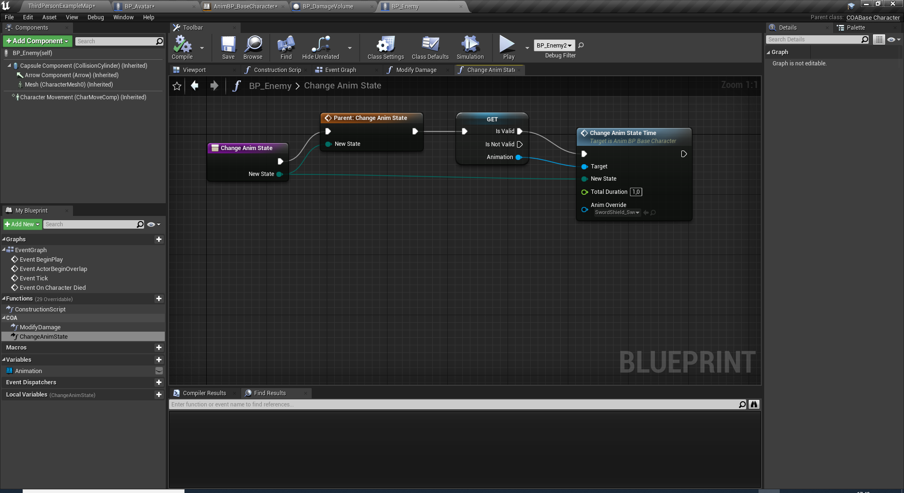
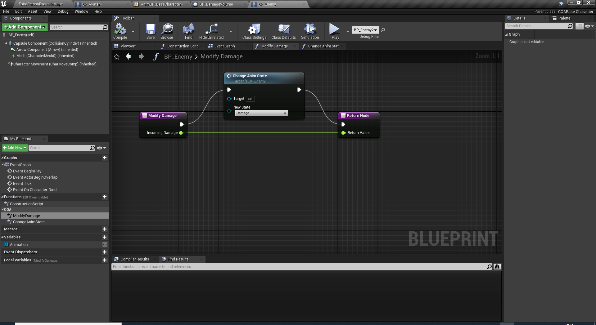
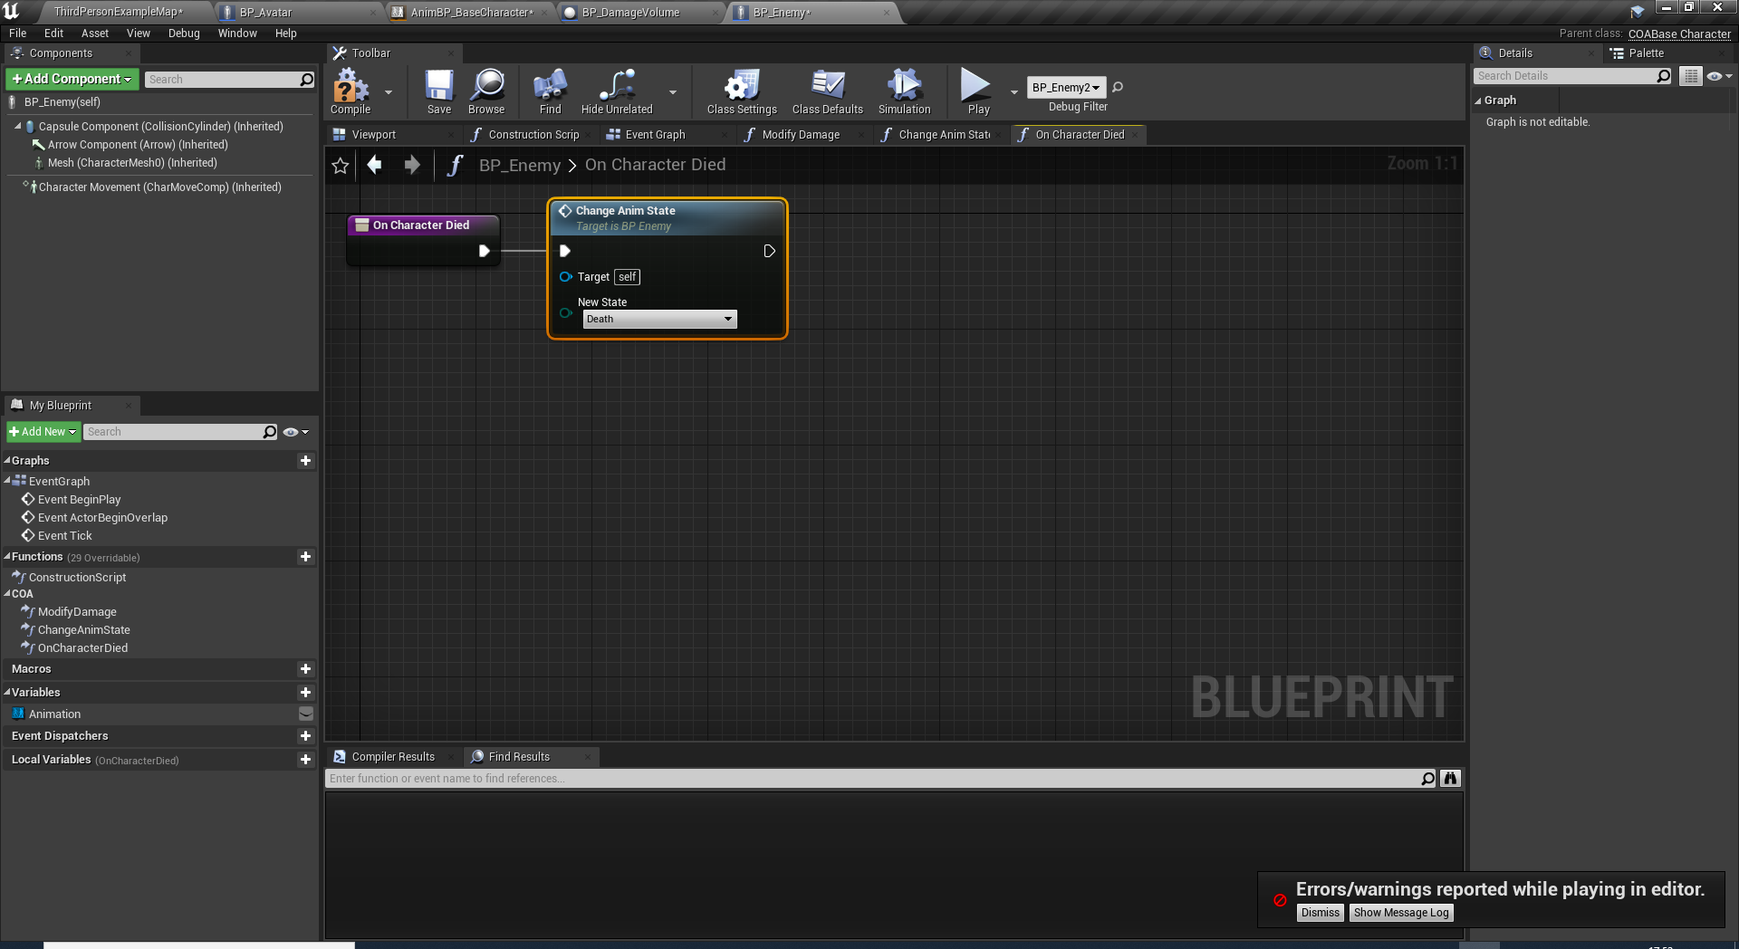
BP_ENEMY
Replace all ChangeAnimState instances in BP_Avatar.
Create ChangeAnimState function for BP_Enemy as well. But the state changes are not so complex as BP_Avatar. It directly sets the state in this version.
Animation variable can be <None> when the state is initially set by C++ code. So make sure it is a validated GET when used.
Override ModifyDamage in BP_Enemy to change the animstate to Damage.
Override OnCharacterDied to set death state only.

Slide 14
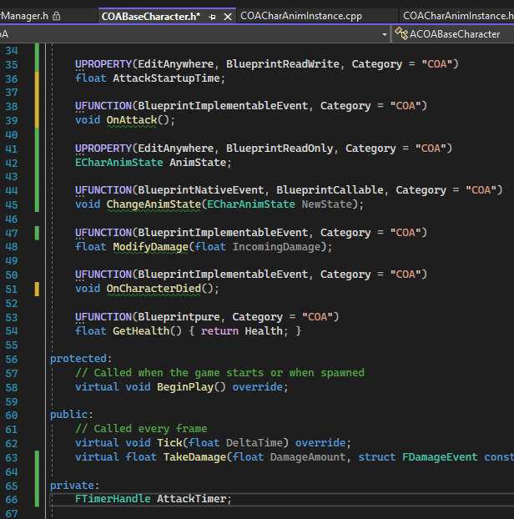
DAMAGING WITH ATTACKS
For the attack damage check, add AttackStartupTime float variable.
We will be declaring the damage moment with an OnAttack event and let the blueprint deliver the damage.
For this, we will also add OnAttack(BlueprintNativeEvent) and use a timer to be fired in ChangeAnimState function.
So we will need a FTimerHandle to start and stop the timer when necessary.

Slide 15
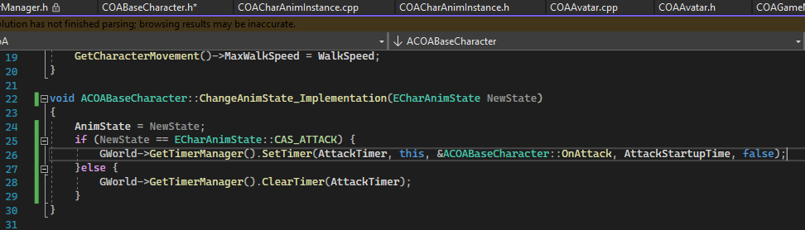
DAMAGING WITH A TIMER
ChangeAnimState_Implementation will only be called if we were successfully able to translate into «Attack» state.
If the newstate is attack then we will start the timer, otherwise we will stop/clear the timer in case we are interrupted like a damaging attack from the enemy.

Slide 16
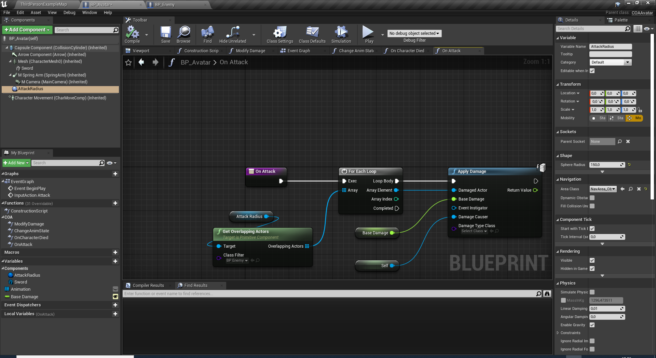
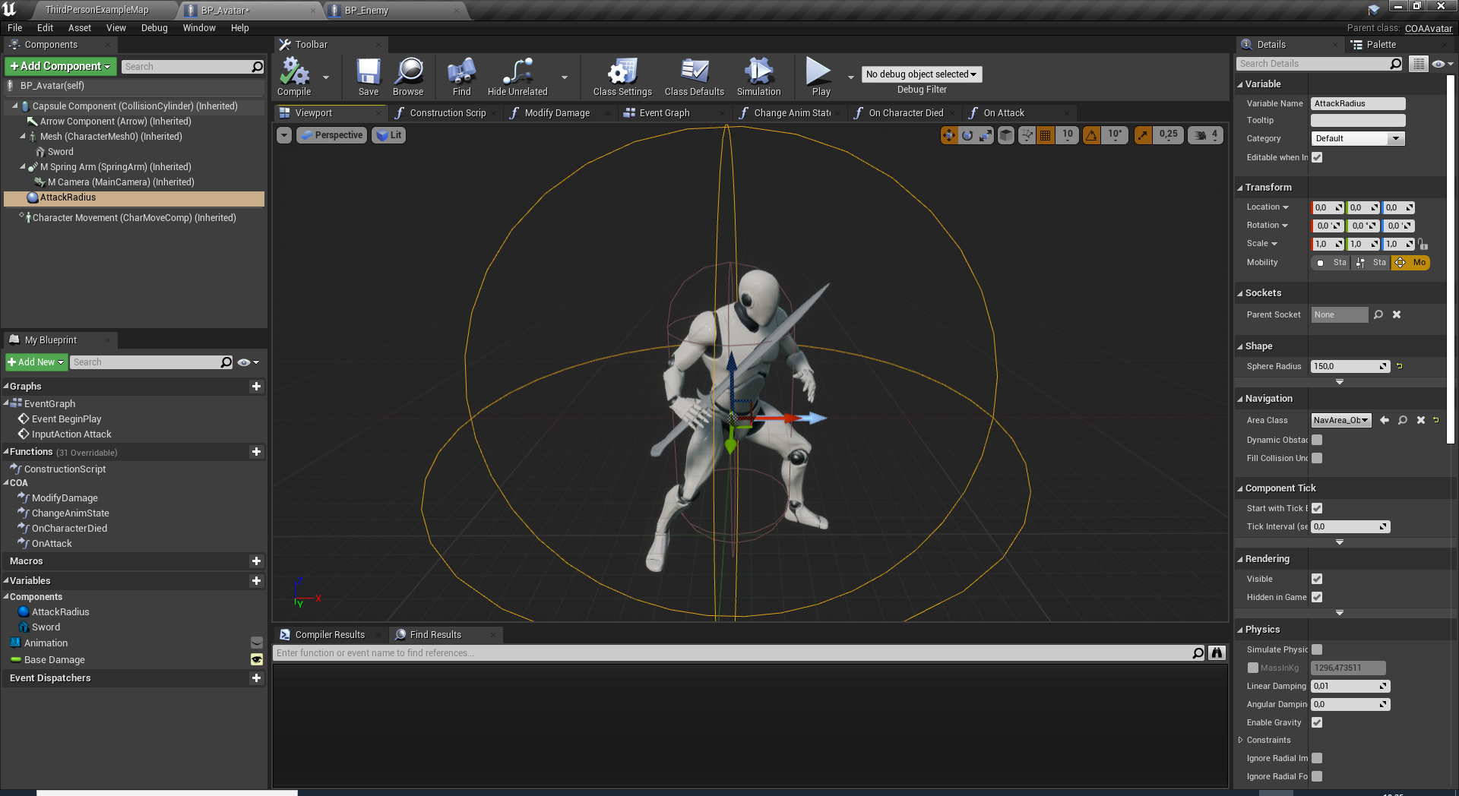
ATTACK RADIUS
Add a SphereCollision to the BP_Avatar to detect the enemies around the player.
Implement OnAttack event as it will apply damage yo all the BP_Enemy instances colliding with the AttackRadius.

Slide 17
HINTS:
Consider using DotProductTo() function of Actor class. Or any dot-product operation to check facing enemies/player. NO COLLISIONS for this labwork!
Consider adding a NavMeshVolume to use the existing pathfinding blueprint nodes like AIMoveTo.
LABWORK:
ATTACK/DAMAGE SYSTEM
Make the avatar only damage the facing enemies. Damaging multiple enemies is okay!
Add a secondary attack button (Right Mouse). This attack will be slower, use a different animation, has more damage area and inflict more damage.
Make the enemies chase and melee attack the player.They should stop attacking if the player is dead.
Enemies should also hit the player if they are facing him/her.
Make enemies move faster than default. (MaxWalkSpeed > 100)

Slide 18
Conclusion
Questions?

